Slide 1
Module 8 Portfolio Project
Option #2: Capstone Project - Non-U.S. Organization
Nikhil Channanathil Raj
MIS581-1 Capstone – Business Intelligence and Data Analytics
Colorado State University – Global Campus
Dr. Chris den Heijer
July 04, 2020

Slide 2
Introduction
The aim of this study is to perform a comprehensive assessment of mortality and loss of health due to injuries and diseases for all the regions of the world.
The study will be beneficial for World Health Organization to support nations worldwide to promote healthy environment.
This objective of this study is to conduct a wide range of evaluations and detailed finding to illustrate how we can improve the environment to promote good health and well-being.
Notes:
Introduction
The aim of my study is to perform a comprehensive assessment of mortality and loss of health due to injuries and diseases for all the regions of the world. Here I have chosen the public data set ‘Deaths attributable to the environment by disease and region Estimates’ from World Health Organization for my portfolio project. The study will be beneficial for WHO to support the countries in developing and understanding the strength and weakness of their health systems, with a focus on disease causing most deaths. WHO is chosen because it is essential for all nations worldwide to promote healthy environment and a platform to discuss international health issues. They helped them from worldwide pandemics and epidemics. This project is aimed to conduct a wide range of evaluations and detailed findings to illustrate how we can improve the environment to promote good health and well-being.

Slide 3
World Health Organization
Established on April 7 1948 after the Second World War.
United Nations specialized agency which is responsible for international public health.
WHO works worldwide to promote human health and to keep the world safe.
WHO gather the data from worldwide on universal health issues through World Health Survey and offers health statistics, measure and expert assessment.
Notes:
World Health Organization
WHO was established on April 7 1948 after the Second World War. It is United Nations specialized agency which is responsible for international public health. The day which WHO established is honored as World health day. The WHO is headquartered in Geneva, Switzerland. It has six regional offices and 150 field office with around 7000 employees. The WHO works worldwide to promote human health and to keep the world safe. It does a multitude of roles internationally including monitoring public health risks, supporting universal health care, fighting communicable diseases like HIV and tuberculosis, and supporting better nutrition, and organizing responses to health crisis. The WHO gather the data from worldwide on universal health issues through World Health Survey. It also offers health statistics, measure and expert assessment of universal health topics on all countries. Additionally it also serves as a forum to discuss health issues.

Slide 4
Dataset and Benefits to the organization
The dataset ‘Deaths attributable to the environment, by disease and region Estimates’ is taken from the Global Health Observatory data Portal of WHO.
The dataset provides a comprehensive picture of various causes of mortality rate between children and adults.
Contains information about the mortality rate of various diseases and causes across different regions of the world in the year 2012.
A good knowledge of the disease influence of different environmental factors will help WHO to design proper and effective health measures.
Notes:
Dataset and Benefits to the organization
WHO was established on April 7 1948 after the Second World War. It is United Nations specialized agency which is responsible for international public health. The day which WHO established is honored as World health day. The WHO is headquartered in Geneva, Switzerland. It has six regional offices and 150 field office with around 7000 employees. The WHO works worldwide to promote human health and to keep the world safe. It does a multitude of roles internationally including monitoring public health risks, supporting universal health care, fighting communicable diseases like HIV and tuberculosis, and supporting better nutrition, and organizing responses to health crisis. The WHO gather the data from worldwide on universal health issues through World Health Survey. It also offers health statistics, measure and expert assessment of universal health topics on all countries. Additionally it also serves as a forum to discuss health issues. The dataset ‘Deaths attributable to the environment, by disease and region Estimates’ is taken from the Global Health Observatory (GHO) data Portal of WHO. The dataset contains the information about the mortality rate of various diseases and causes across different regions of the world in the year 2012. This dataset provides a comprehensive picture of various causes of deaths. It can be used to get a wide knowledge to guide health policy and enhance other environmental and health measures of population heath which depends on cause of death. Collection and analyzing data on disease and death will helps us to understand why people became sick and what kills them. By knowing this we will be able to take proper measures and health care investment to save people life and improve the health worldwide.

Slide 5
Dataset Description
Dataset contains the information about mortality rate and different cause’s mortality across different part of the world in the year of 2012.
It includes 62 different causes of death and corresponding mortality rate of different regions in the world.
Mortality rate of all age groups and children between the age 0 and 4 are provided separately in the file.
Total of 12 attributes and 62 observations from different parts of the world are present in the file.
Notes:
Dataset Description
The WHO dataset ‘Deaths attributable to the environment, by disease and region Estimates’ is taken the data portal of WHO. This dataset have the information about mortality rate and different cause’s mortality across different part of the world in the year of 2012. It was last modified in the year 2016. This dataset offers a complete picture of different reason of deaths across world. We can use this data to get a broad information to lead the health policy and to improve health and other environmental measures to minimize the cause of death. This dataset have the information about 62 different causes of death and corresponding mortality rate of different regions in the world. Also for each causes, the mortality rate of all age groups and children between the age 0 and 4 are provided separately in the file. This information helps to further analyze and find out the major reasons causing mortality in children. So ‘World Health Organization can take preventive measure to minimize the mortality rate in children. The dataset contains total of 12 attributes and 62 observations from different part of the world.

Slide 6
Tools and Techniques Used to Analyze dataset
SAS program is used to perform statistical test and analysis on WHO dataset.
SAS offers complete range of statistical functions and a great handler of data.
The data is visualized using Tableau to have a better understanding of it.
Tableau helps to easily transform the raw data and makes the data analysis fast and easy.
Notes:
Tools and Techniques Used to Analyze dataset
Here we have used SAS program to perform statistical test and analysis on WHO dataset. SAS It is a powerful tool for analyzing statistical data. The SAS software provides a new generation of business intelligence software and services, it is a powerful business intelligence tools which facilitates analyses, reporting, data mining with the help of interactive and powerful visualization. SAS stands for statistical analytics software. The core use of SAS is retrieve, report and analyze the statistical data. Also we have used Tableau to visualize the data. SAS is a powerful visualization tool with variety of visualization styles and it is widely used in the industry for business intelligence. It helps to easily convert the raw data into an easily understandable format. Tableau is one of the best tool for creating visual dashboards. This tool is used to explore data with unlimited visual analytics. The visualization build using Tableau can be easily understood by a professional or a non-technical user at any level of the company.

Slide 7
Hypothesis
According to Macleod & Hockey (1981), a hypothesis a formal statement or prediction that is suggested by limited knowledge or observation which yet to prove or disapprove.
Ho (Null hypothesis): There is no significant difference in the mortality rate between children (age 0-4 years) and adults.
Ha (Alternate hypothesis): There is a significant difference in the mortality rate between children (age 0-4 years) and adults.
Notes:
Tools and Techniques Used to Analyze dataset
According to Macleod & Hockey (1981), a hypothesis a formal statement or prediction that is suggested by limited knowledge or observation which yet to prove or disapprove. Hypothesis enables the researchers to evaluate the research statement and main thoughts involved in the research. It is an uncertain statement or prediction about the relationship of two or more variables. It is a testable statement regarding what we can anticipate to happen in a research or study. Usually hypothesis starts with a question, which is then further evaluated and explored through background research. Hypothesis testing is an important method in statistics to two evaluate two mutual statements on a sample population of data, to see which statement or explanation is supported by the sample data. In our study the null research null hypothesis is "There is no significant difference in the mortality rate between children (age 0-4 years) and adults". The alternate hypothesis is "There is a significant difference in the mortality rate between children (age 0-4 years) and adults".

Slide 8
Statistical test
Two Sample T-test is used to test the hypothesis.
T-test is one of the common method in statistics to evaluate hypothesis.
Two Sample T-test test the statistical difference between means of two independent population.
It enables evaluating an assumption applicable to a population.
Notes:
Statistical test
A T-test is one of the common method in statistics to evaluate hypothesis. It is used to determine if there is a significant difference in the means between two groups. A t-test can be used as hypothesis testing tool which enables evaluating an assumption applicable to a population. There are different types of T-test’s and here we have used two sample T-test to evaluate the hypothesis. It is used to test the statistical difference between means of two independent population. It is also called as independent T-test. Since we are going to compare the means of two independent groups we have used two sample T-test. We can use this test only when the two samples comes two independent group, here our sample data are from two different population group child and adult.

Slide 9
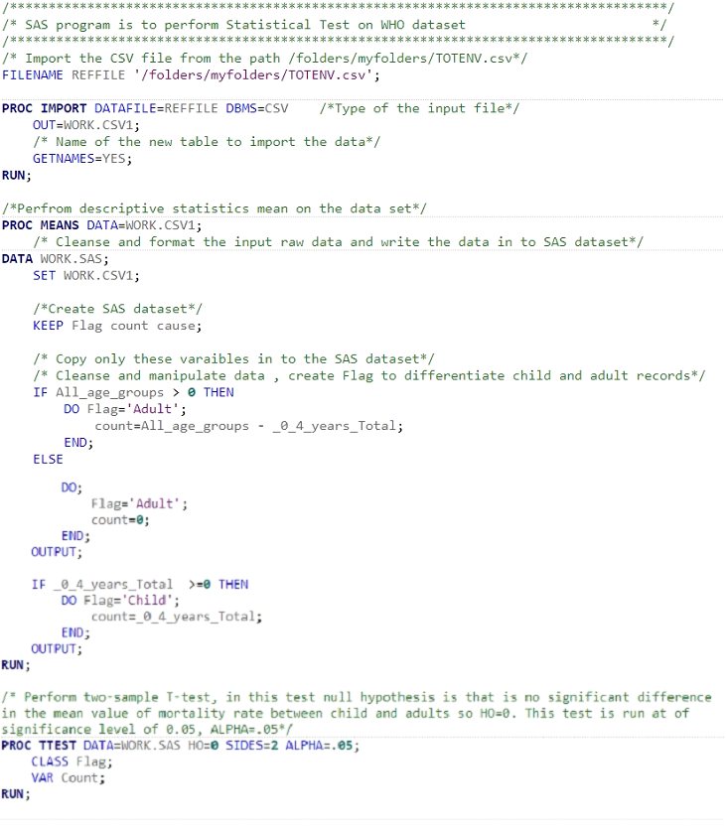
SAS Program Used to perform Two Sample T-test
SAS program is used to cleanse the data set.
SAS PROC TTEST procedure is used to perform two-sample t-test.
Notes:
SAS Program used to perform two sample T-test
Here is the SAS program I have used to test the hypothesis. I have used the SAS to cleanse the data set and SAS PROC TEST procedure to perform the two sample t test. The SAS PROC TTEST procedure is used to test for the equality of means for a two-sample t-test. We have run the test at significance level of .05, alpha =.05.

Slide 10
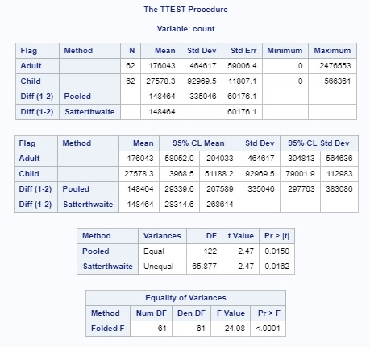
SAS Statistical Test - Output
62 observations in the file
P value is .0150 and value for degree of freedom is 122
P value is less than the alpha value .05.
Notes:
Statistical test
The figure shows the output of SAS procedure, we can see that there are 62 observations in the file. The means and standard deviation for adult and children in the data set are shown in the result. The total mean for adult record is 176043 and child record is 27578.3 Here the P value is .0150 and value for degree freedom is 122. Here the P value is .0150 which is less than the alpha value .05.

Slide 11
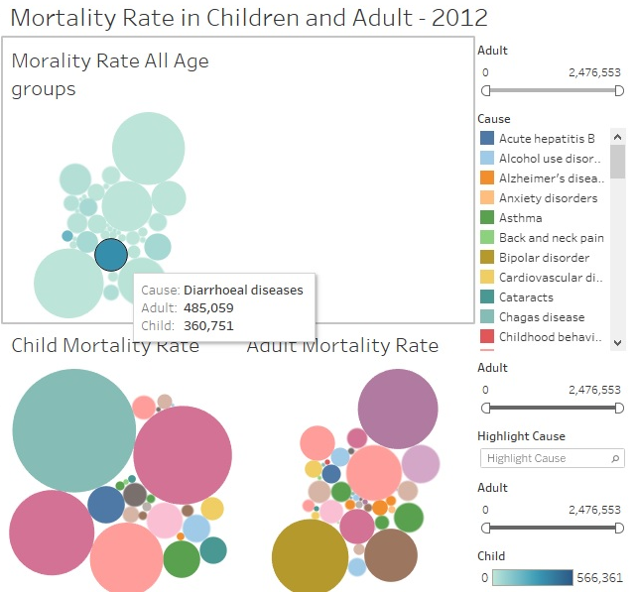
Tableau Dashboard Report
Bubble chart is used to
visualize the mortality rate
between child and adults.
Main cause of mortality in
children as diarrheal diseases.
In adults main cause of
mortality is Ischemic
heart disease.
Notes:
Tableau Dashboard Report
Here we have used bubble chart in Tableau to visualize the mortality rate between child and adults. A bubble plot is an extension of the scatter plot used to visualize the relationships between variables. The Tableau report shows that the main cause of mortality in children are diarrheal diseases and lower respiratory infections where in adults are Ischemic heart disease and Stroke.

Slide 12
Hypothesis Test – Findings
Null hypothesis is rejected.
P value is .0150 which is less than the alpha value .05.
There is a significant difference in the mortality rate between children (age 0-4 years) and adults.
Overall mortality rate is higher in adults compared to Children.
Notes:
Hypothesis Test – Findings
In our hypothesis test , the P value is .0150 which is less than the alpha value .05 and value for degree freedom is 122. Here the P value .0150 which is less than the alpha value .05, so we reject null hypothesis. It mean there is a significant difference in the mortality rate between children (age 0-4 years) and adults. Also in the Tableau dashboard report, we can see that overall mortality rate is higher in adults compared to Childs. But there are disease like diarrhoeal is having the child mortality rate closer to adults. So additional actions and health measures needs to be taken to minimize the mortality rate for Childs and adults. Hence our study shows that there is a significant difference in mortality rate between children (age 0-4 years) and adults. It also reveals that main cause of mortality in children are diarrheal diseases and lower respiratory infections where in adults are Ischemic heart disease and Stroke.

Slide 13
Factors Influenced the Results & Recommendations
Study was done on data collected by WHO for the year of 2012
Unavailability of data limits scope of our study and thus effect overall research result
Data limitation may result bias in this research study
Further research is recommended with larger group of data to achieve more accurate results
Notes:
Factors Influenced the Results & Recommendations
The research result shows that there is a significant difference in the mortality rate between children and adults. But this study was done on data collected by WHO for the year of 2012. Since we did our study based on the 2012 data may make it hard to determine if a particular outcome is true. The unavailability of data limits scope of our study and thus effect overall research result. This data limitation may result bias in this research study. So further research is recommended with larger group of data to achieve more accurate results.

Slide 14
Conclusion
Study was done on data collected by WHO for the year of 2012
Unavailability of data limits scope of our study and thus effect overall research result
Data limitation may result bias in this research study
Further research is recommended with larger group of data to achieve more accurate results
Notes:
Conclusion
I have used the WHO dataset to challenge my analysis and also the study on the mortality rate between adults and child are very important because it helps to find the important cause of mortality in adults and Childs. The WHO can take essential measures and actions to prevent or minimize the important cause of death. They can assess and evaluate the current health measures and medicines available for the disease and modify the health guide lines and prefer new effective medication methods for the cause of the mortality. This will help to bring down the mortality rate and to build a healthy world.

Slide 15
References
AIHW. (2012). Multiple Causes of Death, Bulletin (Australian Institute of Health and Welfare).
Global Health. (2020).World Health Organization: what does it do and how does it work? Retrieved from https://www.weforum.org/agenda/2020/04/world-health-organization-what-it-does-how-it-works/
Jennyfer Wolf. (2016). Diseases due to unhealthy environments: An updated estimate of the global burden of disease attributable to environmental determinants of health. Retrieved from https://www.researchgate.net/publication/308033579_Diseases_due_to_unhealthy_environments_An_updated_estimate_of_the_global_burden_of_disease_attributable_to_environmental_determinants_of_health
Khan A, Plana-Ripoll O, Antonsen S, Brandt J, Geels C, & Landecker H. et al. (2019). Environmental pollution is associated with increased risk of psychiatric disorders in the US and Denmark. PLOS Biology, 17(8), e3000353. https://doi.org/10.1371/journal.pbio.3000353
Landrigan P, Sly J, Ruchirawat M, Silva E, Huo X, & Diaz-Barriga F. et al. (2016). Health Consequences of Environmental Exposures: Changing Global Patterns of Exposure and Disease. Annals of Global Health, 82(1), 10. https://doi.org/10.1016/j.aogh.2016.01.005
Tableau. (2012). Dashboards. Retrieved from https://help.tableau.com/current/pro/desktop/en-us/dashboards.htm
Prüss-Ustün. (2012). Diseases due to unhealthy environments: an updated estimate of the global burden of disease attributable to environmental determinants of health. Retrieved from https://www.ncbi.nlm.nih.gov/pmc/articles/PMC5939845/

Slide 16
References (continued)
Prüss-Ustün. (2012). Diseases due to unhealthy environments: an updated estimate of the global burden of disease attributable to environmental determinants of health. Retrieved from https://www.ncbi.nlm.nih.gov/pmc/articles/PMC5939845/
Van Deventer E, Mudu P, Campbell-Lendrum D, Vickers C, Ivanov I, & Forastiere F. et al. (2019). Environmental risks and non-communicable diseases. BMJ, l265. https://doi.org/10.1136/bmj.l265
WHO. (2016). Preventing disease through healthy environments. Retrieved from https://apps.who.int/iris/bitstream/handle/10665/204585/9789241565196_eng.pdf;jsessionid=802319665CEF12B23E9403DB4FFAA7AA?sequence=1
WHO. (2012). Deaths attributable to the environment, by disease and region Estimates. Retrieved from https://apps.who.int/gho/data/node.main.ENVDEATHSBYDISEASE?lang=en

